Slide 1
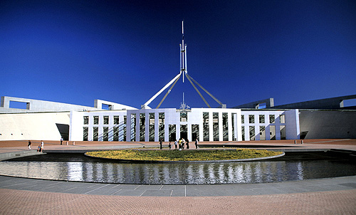
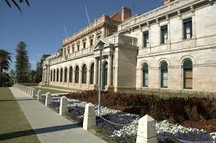
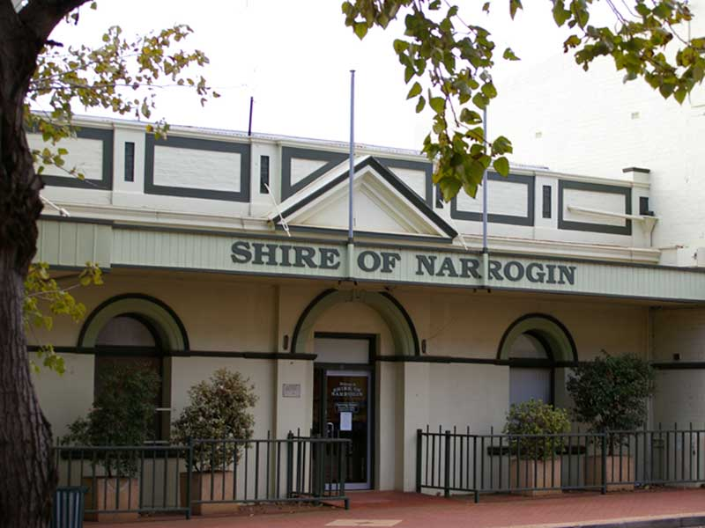
Making a law - parliament

Slide 2
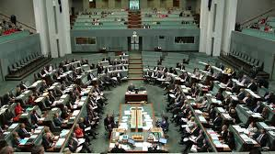
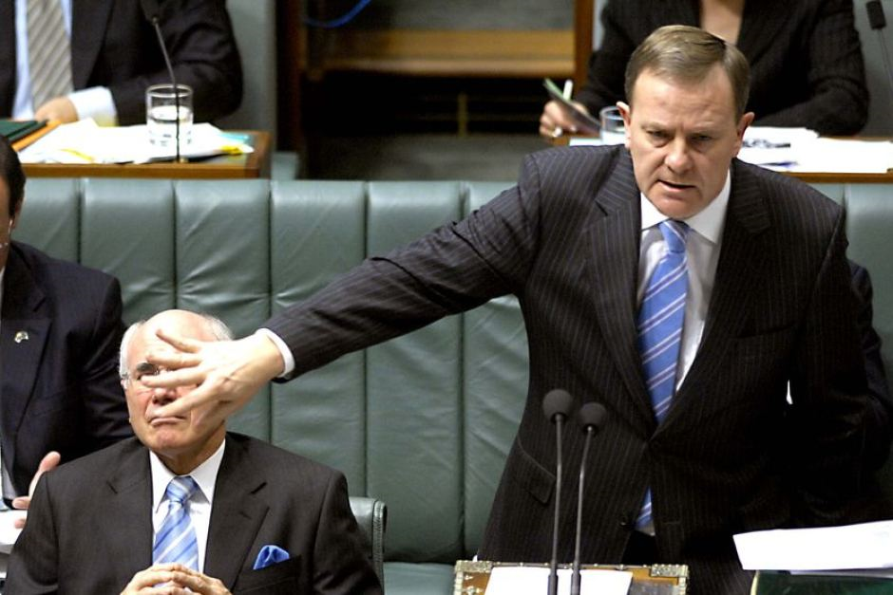
Introduction
A bill is a proposed law that needs to pass through both houses of Parliament before it becomes law.

Slide 3
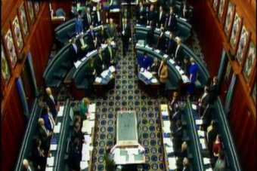
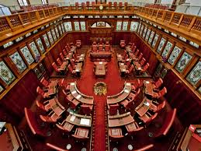
RECALL!
What are the names of the two houses of Federal Parliament?
What are the names of the two houses of State Parliament in WA?

Slide 4
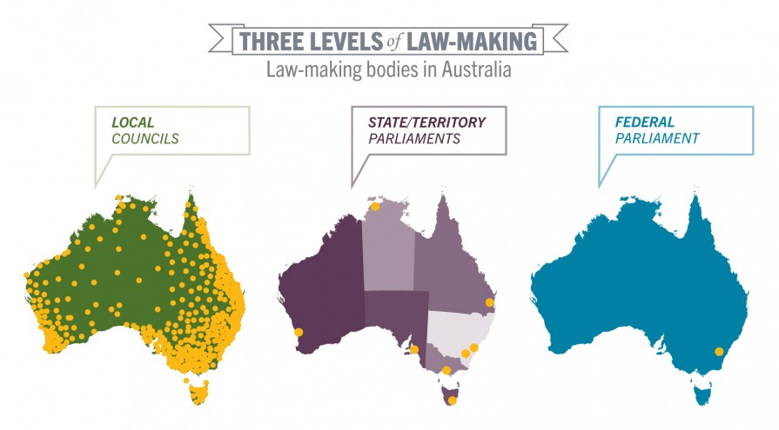

Slide 5
Snapshot of the three levels
https://www.youtube.com/watch?v=-_VOibmffBw

Slide 6
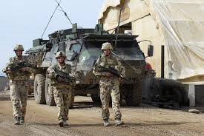
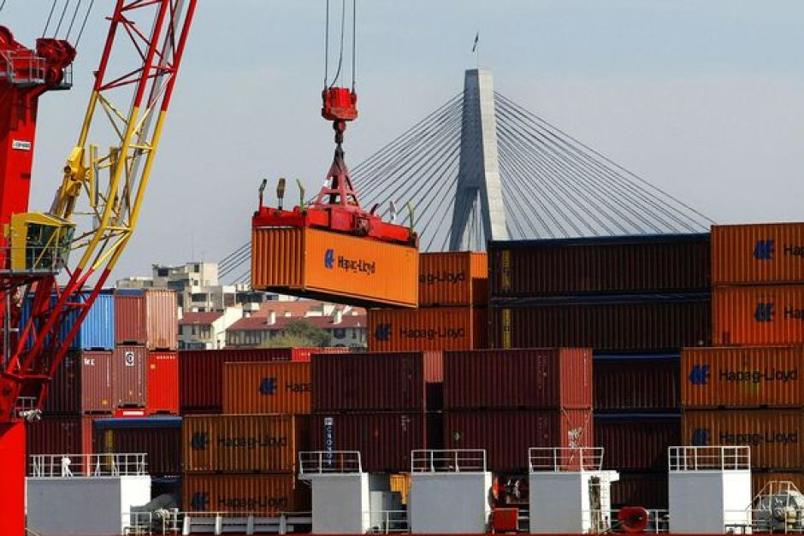
Federal Government Responsibilities
The Federal Government is responsible for:
Trade
Defence,
Immigration
The environment.

Slide 7
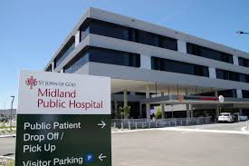
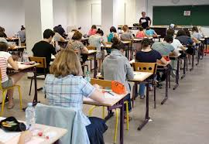
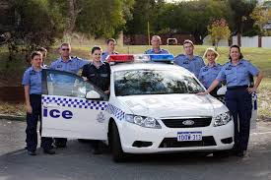
State Government responsibilities
The State/territory governments are responsible for:
Schools
Housing
Hospitals
Major roads and railways
Police and ambulance services.

Slide 8
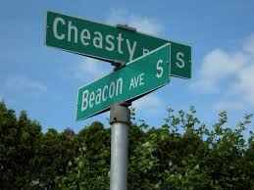
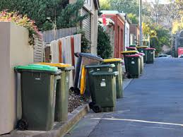
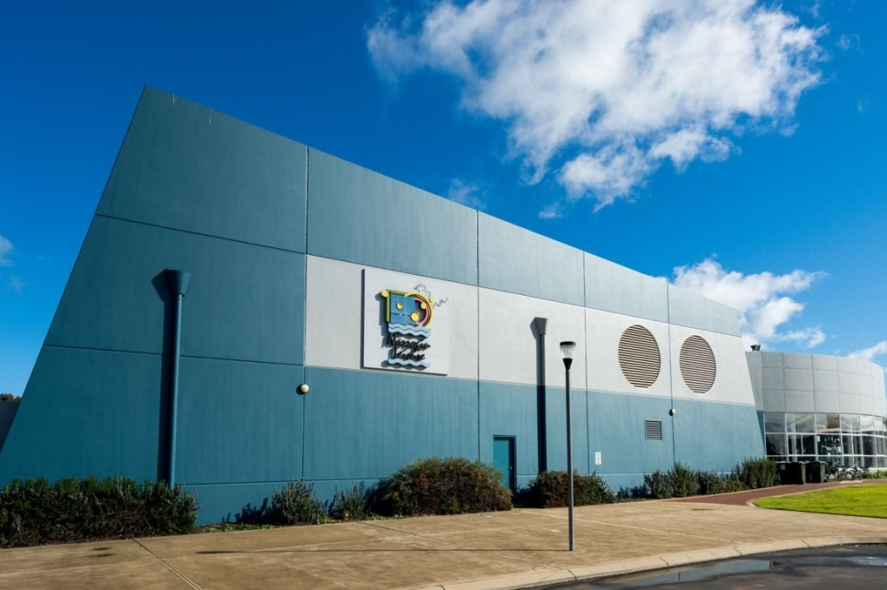
Local Government Responsibilities
Local councils are responsible for:
Town planning
Rubbish collection
Water and sewerage
Local roads
Pet control
Libraries
Recreational Centres
Street signs

